Slide 1
Can healthy diet predict death rates?
According to WHO. “A healthy diet helps to protect against malnutrition in all its forms, as well as noncommunicable diseases (NCDs), including diabetes, heart disease, stroke and cancer.”

Slide 2
Contents
1. Introduction(Statement of problem)
2. Business question
3. Structure of analysis
4. Descriptive analytics
5. Visualization
6. Conclusion

Slide 3
Introduction(Statement of problem)
ㅇThe WHO use the food death analysis to
sponsor the food bank projects in
developing and developed countries
ㅇ Food health and prediction of death rate for
data analysis help the WHO to optimize the
sponsor and better classify food supplies
and nutrition system of each country
Notes:
ㅇThe WHO use the food death analysis to sponsor the food bank projects in developing and developed countries
ㅇ Food health and prediction of death rate for data analysis help the WHO to optimize the sponsor and better classify food supplies
and nutrition system of each country

Slide 4
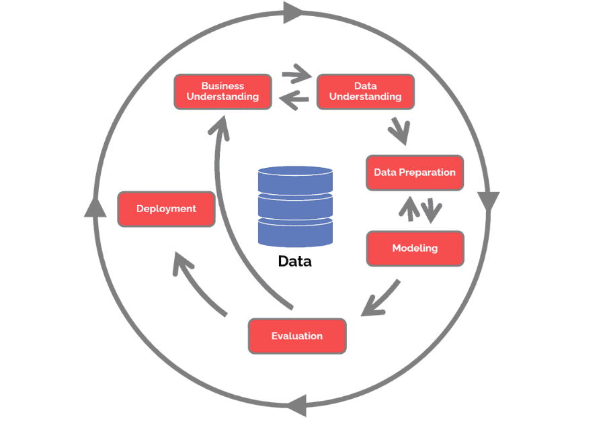
6 CRISP-DM Phases
Business Understanding
Data Understanding
Data Preparation
Modeling
Evaluation
Deployment

Slide 5
Business Goals
ㅇ Business Question
- How accurately the food diet can predict the
countries' death rate?
- Can healthy diet predict the countries death
rate?
ㅇ Food diet features
- Ranking 3 most relevant food diet features
- Why features relevant to specific coutries
Notes:
First, We have to set up Business goals by business understanding. There are following question. ~~
And next, We will figure out the Food diet features. What we are finding are~~

Slide 6
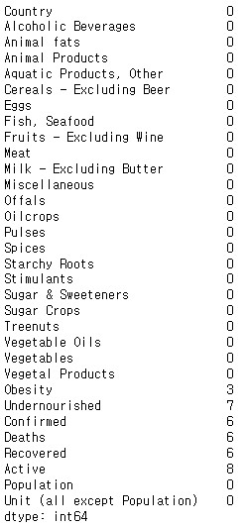
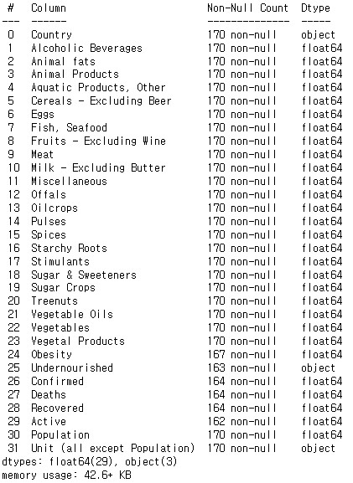
Data consideration
Columns : 31(count : 170)
(Include null : obesity(3), Undernourished(7), Confirmed(6), Deaths(6), Recovered(6), Active(8))
Dtypes : Float(29), Object(2)
Notes:
The following is the data consideration. We have obtained 31 data columns from a large nutritional dataset, and we have selected the columns shown on the next page to analyze the relationship between Food Supply and Death. Below are the identified NULL values during data analysis, and we have considered how to handle them during the data consideration process.

Slide 7
Data consideration
ㅇ Missing values in obesity, deaths
replaced to mean value
ㅇ Unnecessary columns are dropped
Notes:
We replaced the null data to mean value. The null data in obesity, deaths is replaced to mean value.
And, Among the 31columns, We dropped unnecessary columns.

Slide 8
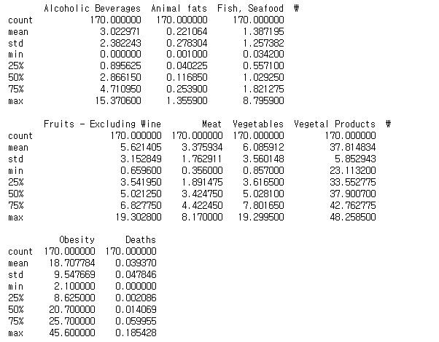
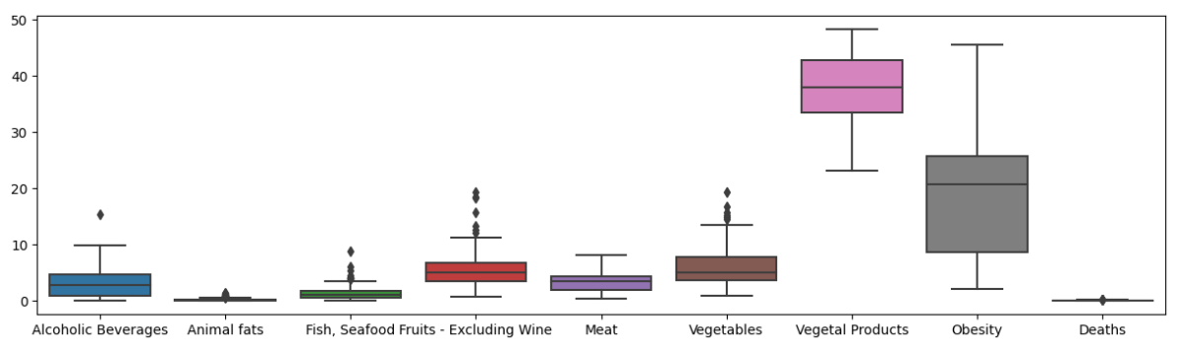
Descriptive analysis
Notes:
So, the columns we selected are Alcoholic Baverages, Animal fats, Fish/Seafood, Fruits(including wines), meat, vegetables, Vegetal Products, Obesity, And Deaths.

Slide 9
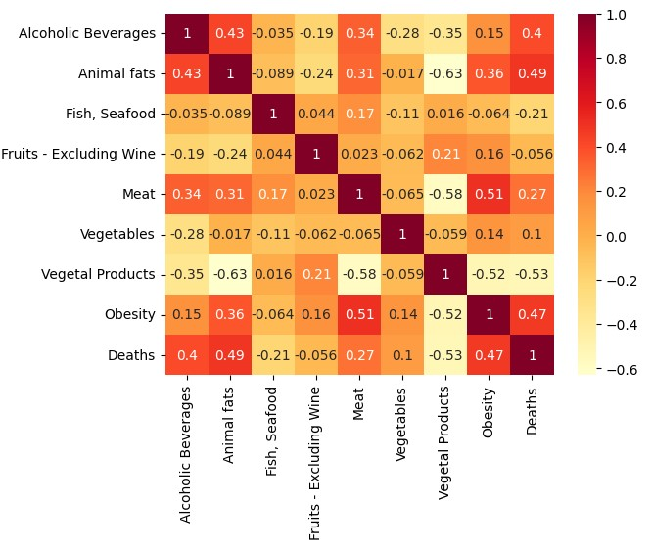
Visualization(correlation coefficient)
Notes:
The picture is heatmap about correlation
coefficient 1.0 is the highest positive correlation -1.0 is the lowest negative correlation
Deaths has positive correlation with animal fats, obesity, alcoholic beverages
They are top 3 positive correlation
About negative correlation between deaths and vegetable products is lowest
And between obesity and meat correlation seems meaningful
what columns I use?
obesity, animal fats, alcoholic beverages, meat, vegetable products

Slide 10
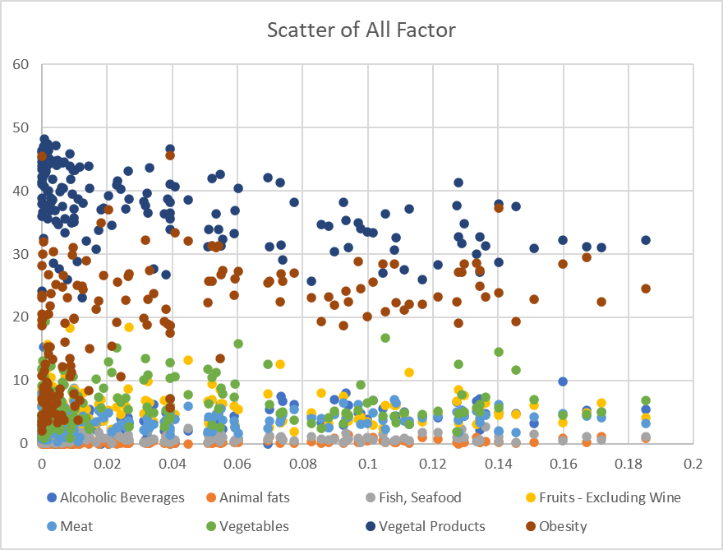
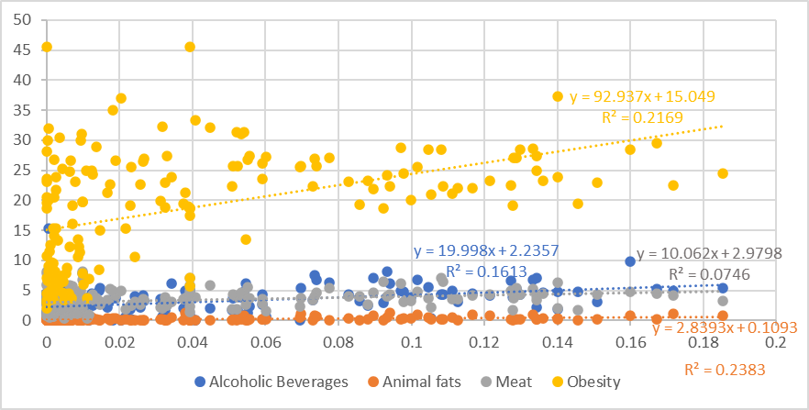
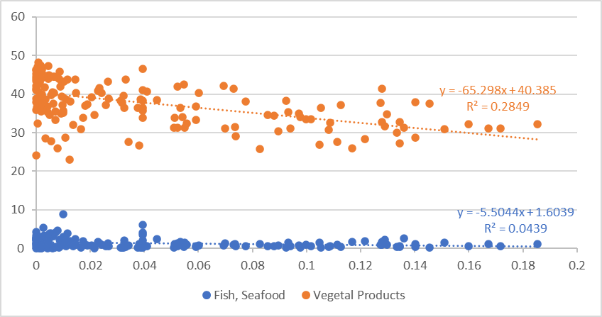
Visualization(scatter plot)
Notes:
This’s the scatter plot
x is Death, y is each columns
let’s see correlation by scatter plot
right side upper plot is analyzed alcoholic beverages, animal fats, meat, obesity
obesity R square is 0.2169 the highest
the bottom of the right side picture
vegetable products R square is 0.2849

Slide 11
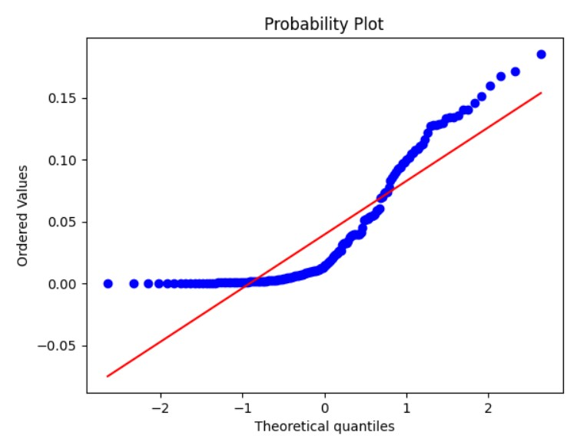
Normality(Shapiro and QQplot)
Shapiro result
H1 = Normality
H2 = No normality
p-value > 0.05
statistic = 0.685718
Linear regression is possible
Notes:
before modeling check linerity, normality, independency, homoskedasticity
for checking normality use shapro result and QQ plot h1 is normality h2 is no normality p-value is over 0.05

Slide 12
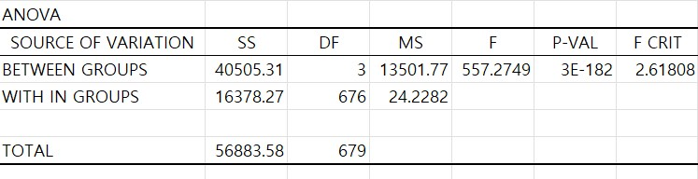

MODELING
Death rates and obestiy, alcoholic, animal fats
Linear Regression Y : Obesity, X : meats
Notes:
use ANOVA and linear regression p-value is under 0.05 so It has significant difference

Slide 13

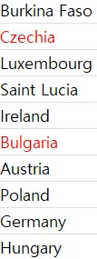
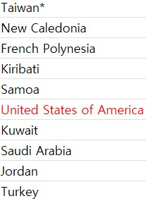
How accurately the food diet can predict the
countries' death rate?
We can tell from our previous data, the regression coefficient is a perfectly positive correlation. It means the food diet has directly relationship with death rate, and it can be used to predict the countries’s death rate as well.
What are the important food diet features that are
used to predict the deaths of specific countries/regions?
Ranking 3 most relevant food diet features
Research on why those food diet features are
relevant to specific countries/regions but not others?
The reason why those places have more Alchol consuming probably is their eating habit.
The reason why those places have more animal fat cosuming is about the cold weather.
The reason why those places have more obesity cosusuming is realted to the eating habit as well.
Output
ALCHOL ANIMAL FAT OBSEITY

Slide 14
Conclusion
According to our data, we can confidently say that the healthy diet can help reduce the death rate of the countries.
Also, according to the NIH. Not eating nuts, seeds ,and seafood mega-3 also can increase the risk of death compared with the people that eat more processed meant and strong sugar drinks.
Later I figure out that the deaths is not just related to the diet, it can also be related to people’s race, and eductioanl level. In my personal opinion, I would think it probably has more directly contacted with wealthiness of people. That would be a interesting topic to figure out as well by using the knowledge we learn from the data analytics class.

Slide 15
Source
Hotz, N. (2023, January 19). What is CRISP DM?. Data Science Process Alliance. https://www.datascience-pm.com/crisp-dm-2/
U.S. Department of Health and Human Services. (2017, March 21). How dietary factors influence disease risk. National Institutes of Health. https://www.nih.gov/news-events/nih-research-matters/how-dietary-factors-influence-disease-risk

